Slide 2
Advanced design training
Leverage visual and coding tools to design

Slide 3
Use the links - do not lose your way!
Coders
Internal API
Code env
Folders
Static insights
Python R notebooks
All
prep data
Flow views and actions
Windows
Top N
Clickers
code for clickers
plug in recipe
Coders
Make your own plugin
Dynamic SQL query
Optional
Optional
Optional
All
SQL notebooks
variables
More coding capabilities
Text visual ML
Geo clustering
Notes:
If you lose your way, please refer to this slides

Slide 4

Advanced Design Training
Remember the West Niles Virus from the discovery training ?
⇒ We designed a pipeline to ingest, clean and visualize data. We also created a model that can be used to forecast West Nile virus presence at different locations in Chicago
In this training
We analyze the public perception of the Virus across the US
Specifically, we will analyze tweets that mentioned the West Nile Virus from years 2007 to 2017
We use and develop various code based features and/or advanced visual features to design a flow

Slide 5

Coder track
This training covers the following coding features
Interacting with datasets using Python or R
Working with Jupyter / SQL notebooks
Creating code environment
Creating visual extension to DSS: plugins
Overview of the different APIs in DSS
Working with folders, variables and much more!
But also some visual features
The window recipe (sliding aggregations)
Mass flow actions
and more!

Slide 6
Clicker track
This training covers the following visual features
Prepare and enrich your data
Mass flow views and actions
Visual interface custom code based (plugin)
Window recipe (sliding aggregations)
But also some more advanced features
SQL notebooks
Working with instance variables
Working with folders
Visual ML with text data
Geo clustering
and much more!

Slide 7
Discover and prepare the data
Hands on

Slide 8
Tweet data
The data
In this section we
Import the tweet data and look at the data
Investigate and clean the text
Use a regex to extract mentioned users Aims: find influencers, build a community graph, …
Find tweets containing “bite”
Remove very short tweets
Simplify and normalize text Aims: make the text usable for further use like finding insights and creating usable data for machine learning

Slide 9
Connecting to your instances
Access to DSS training instances
https://dssX-design-YOUR_COMPANY.hadoop.training.dataiku.com
X = 0, 1, ...
user: userY, Y = 0, 1, ...
password: to be given by the trainer

Slide 10

Tweet data
The data
Tweets that mentions to the West Nile Virus from 2007 to 2017!
TO DO: Create a new project and name it Westnile_tweets_[yourname]

Slide 11

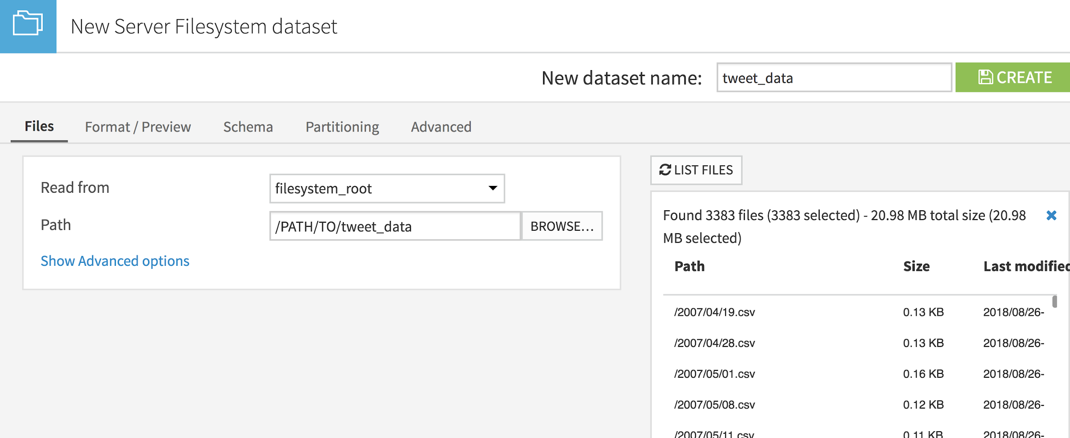
Tweet data
Importing the data
TO DO:
Import the tweet_data from file systems from data/shared/tweet
List the files. We can think to an external process that writes a new file every day
Name the dataset and create it

Slide 12
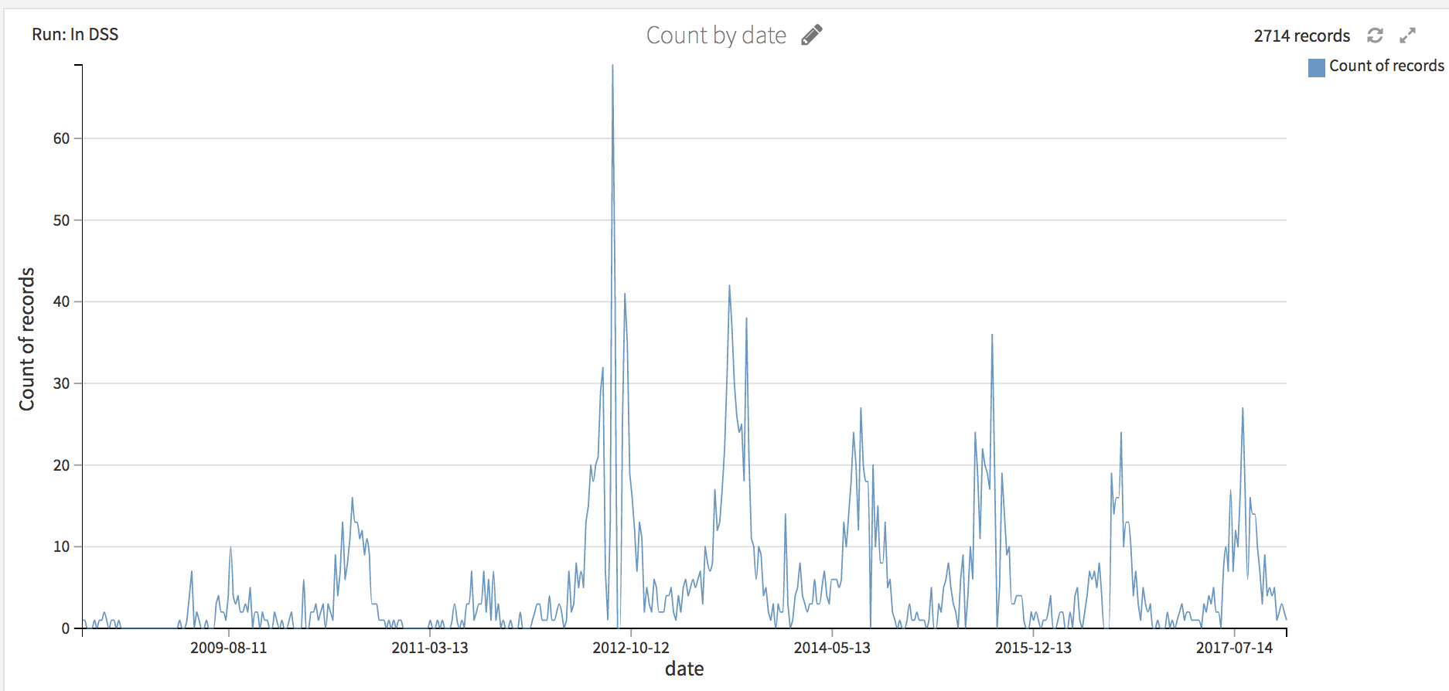
Tweet data
A first insight
TO DO:
Plot a first insight: number of tweets per week ⇒ change the sample if needed!

Slide 13
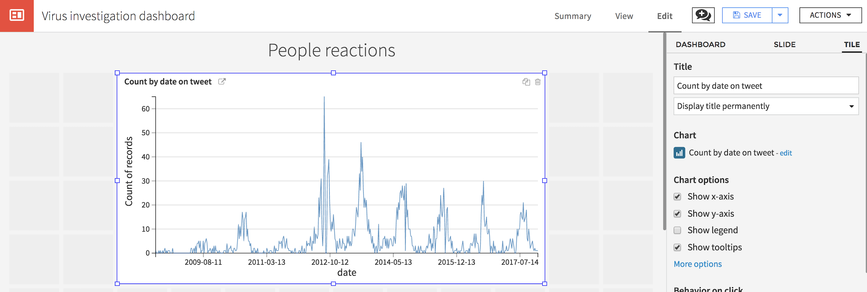
Tweet data
A first insight
TO DO:
Create a dashboard and export the chart
To display the title, go to the slide tab

Slide 14

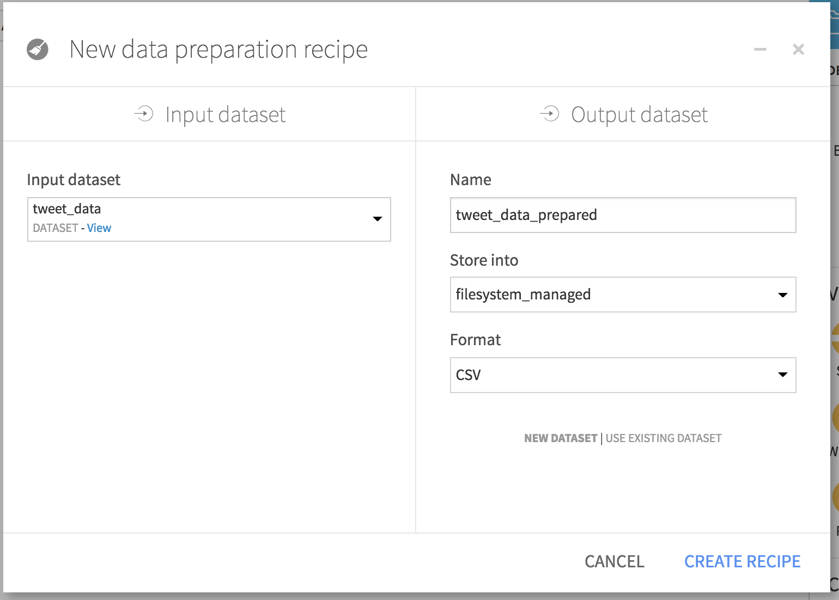
Tweet data
Prepare the data
TO DO:
Create a prepare recipe from the tweet_data dataset.
Store the output as a filesystem (CSV) dataset named tweet_data_prepared

Slide 15
Tweet data
Prepare the data
TO DO:
In the prepare recipe, add a new step that to extract with regular expression all the mentions @user Do not run the recipe yet
A regular expression, or regex, is a sequence of characters that defines a search pattern.
ex:
img_(\w+).* extracts from img_cat.png the word “cat”

Slide 16
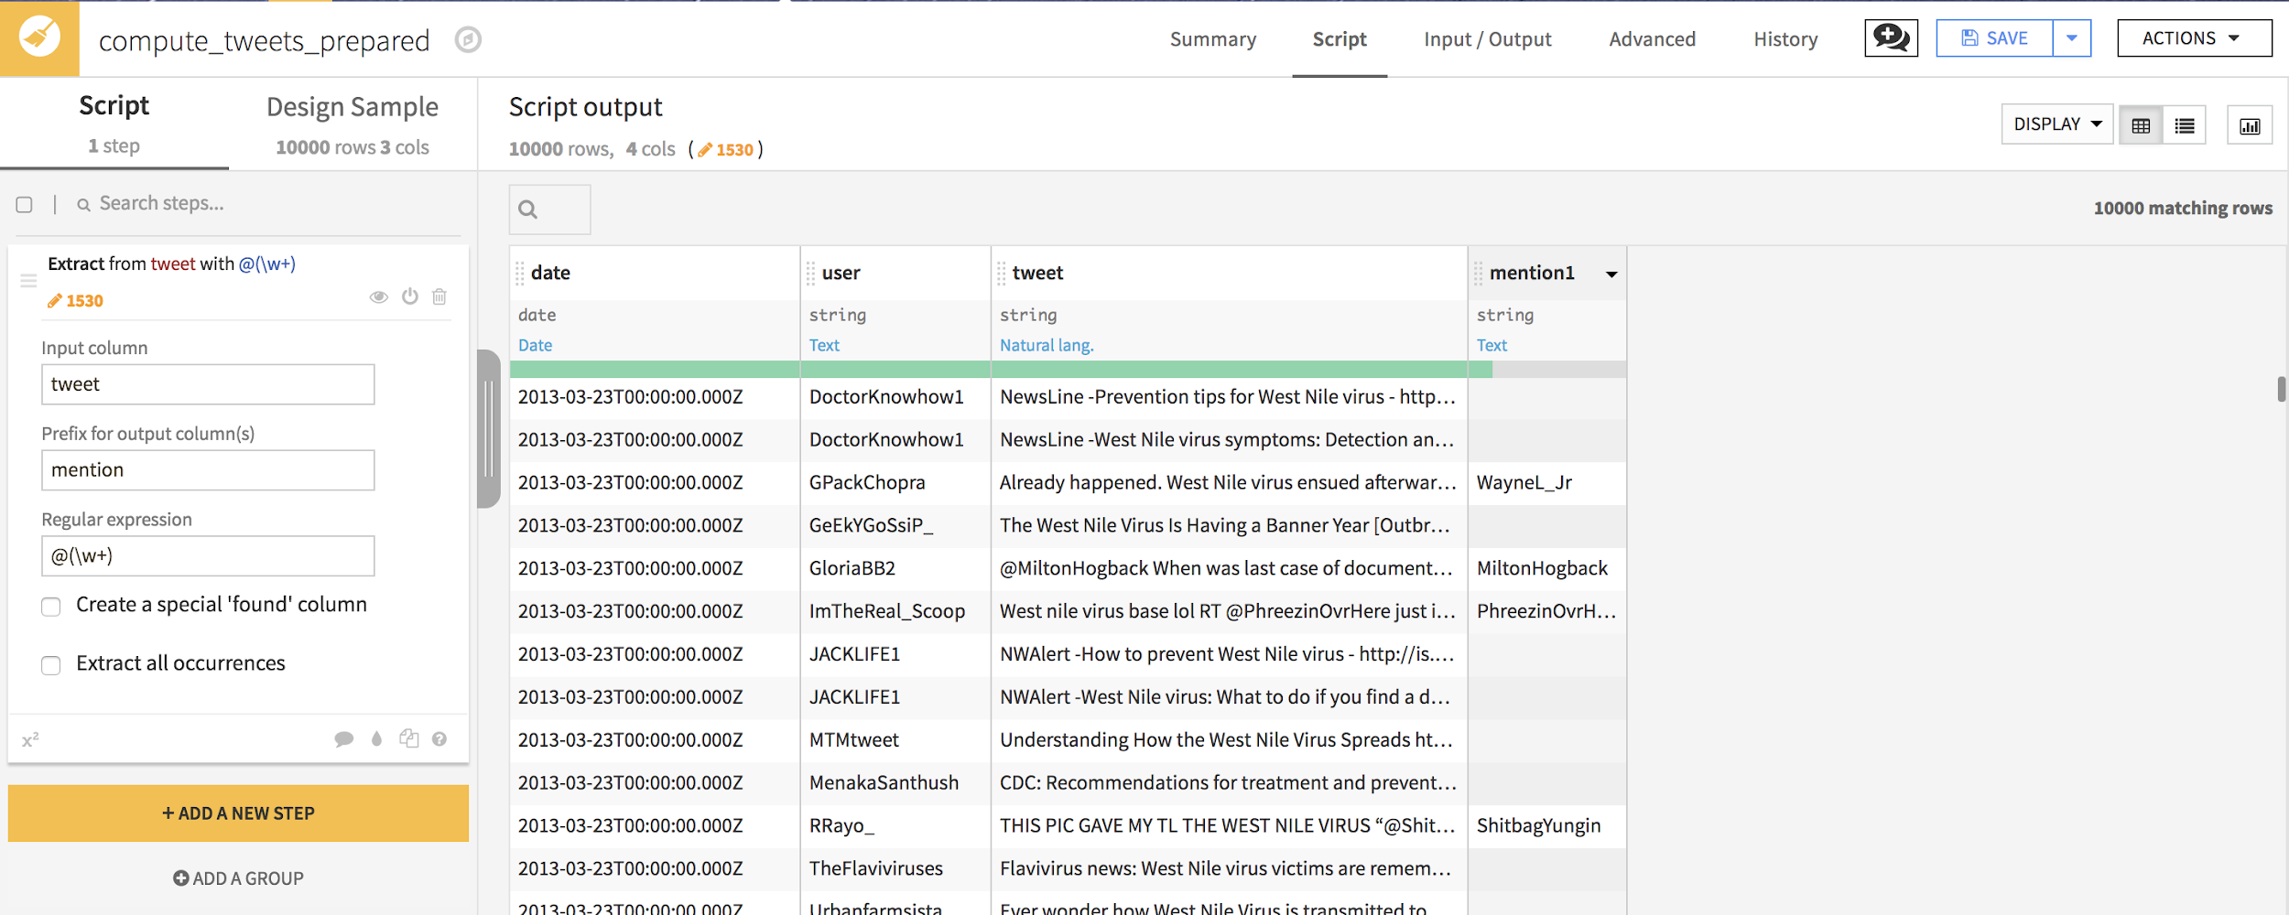
Tweet data
Prepare the data
TO DO:
Extract with regular expression all the mentions @user @(\w+) Do not run the recipe yet

Slide 17
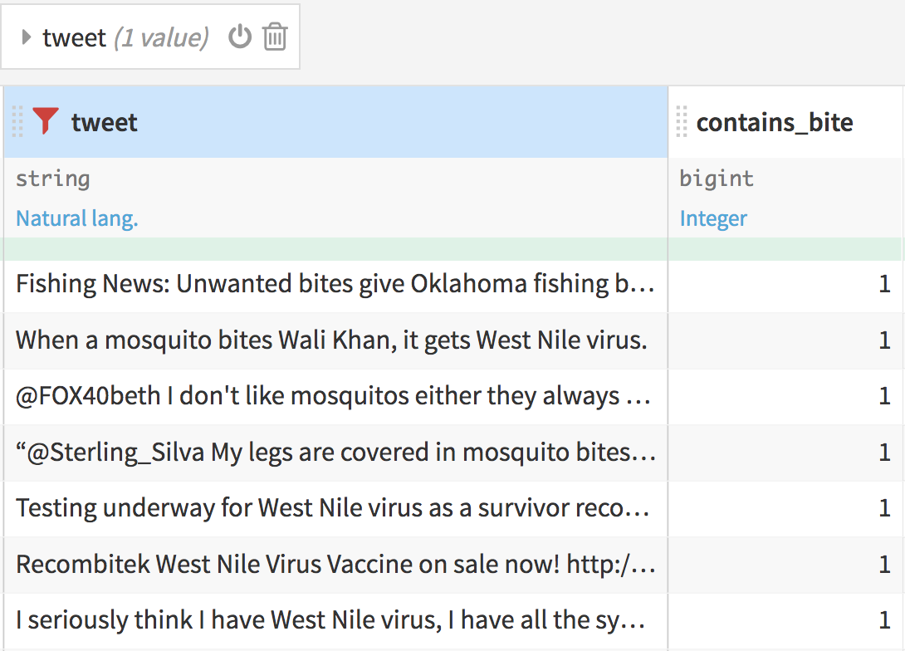
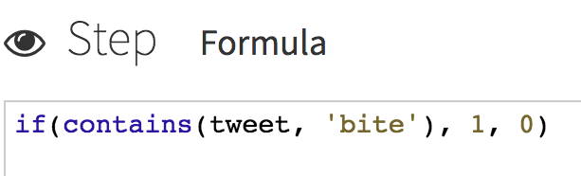
Tweet data
Prepare the data
TO DO:
Create a column to flag if tweet contains “bite” → use a formula with
if
contains
Take a look at the reference !
Check it worked by filtering on the tweet column

Slide 18
Tweet data
Text preparation concepts
CONCEPT
To get insights from text or use machine learning models, it is important not to work with raw text data
Normalize text:
Café → cafe
Stem words:
drinking, friendship → drinking, friendship → drink, friend
Clear stop words:
I drink a cup of coffee → I drink a cup of coffee → drink cup coffee

Slide 19
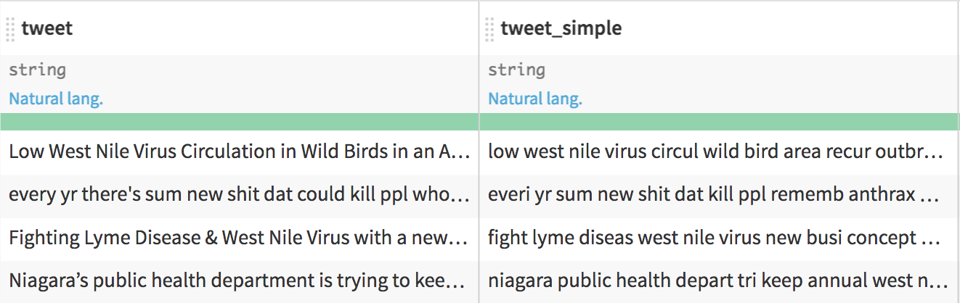
Tweet data
Text preparation concepts
TO DO: Simplify text:
Normalize
Stem words
Clear stop words
Do not run the recipe yet

Slide 20
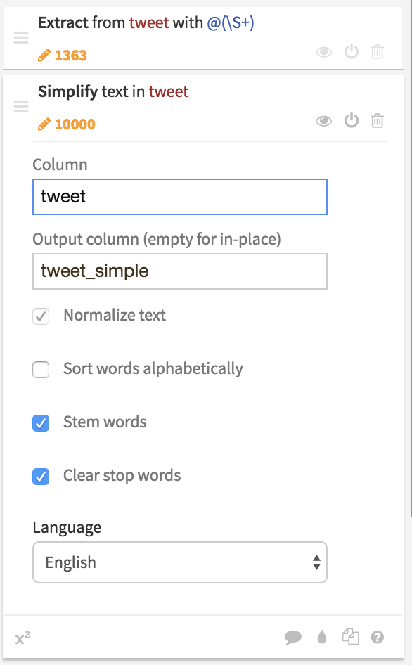
Tweet data
Text preparation concepts
TO DO: Simplify text:
Normalize
Stem words
Clear stop words
Do not run the recipe yet

Slide 21
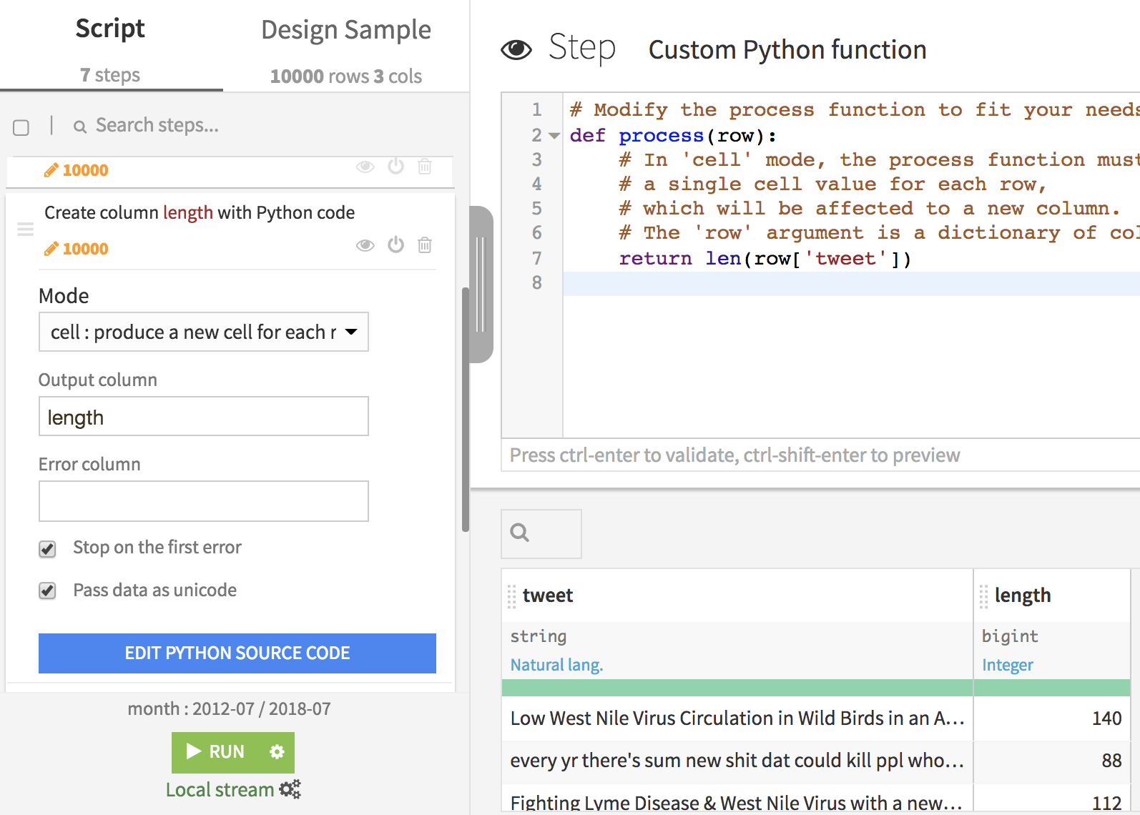
Tweet data
Text preparation concepts
TO DO: Compute length of tweets
If you are a clicker, use a formula
If you are a coder, use a custom Python code processor Beware: if you run the prepare recipe on a cluster, the python code cannot be translated into a Spark job!

Slide 22
Tweet data
Text preparation concepts
TO DO: Compute length of tweets
If you are a clicker, use a formula
If you are a coder, use a custom Python code processor Beware: if you run the prepare recipe on a cluster, the Python code cannot be translated into a Spark job!

Slide 23
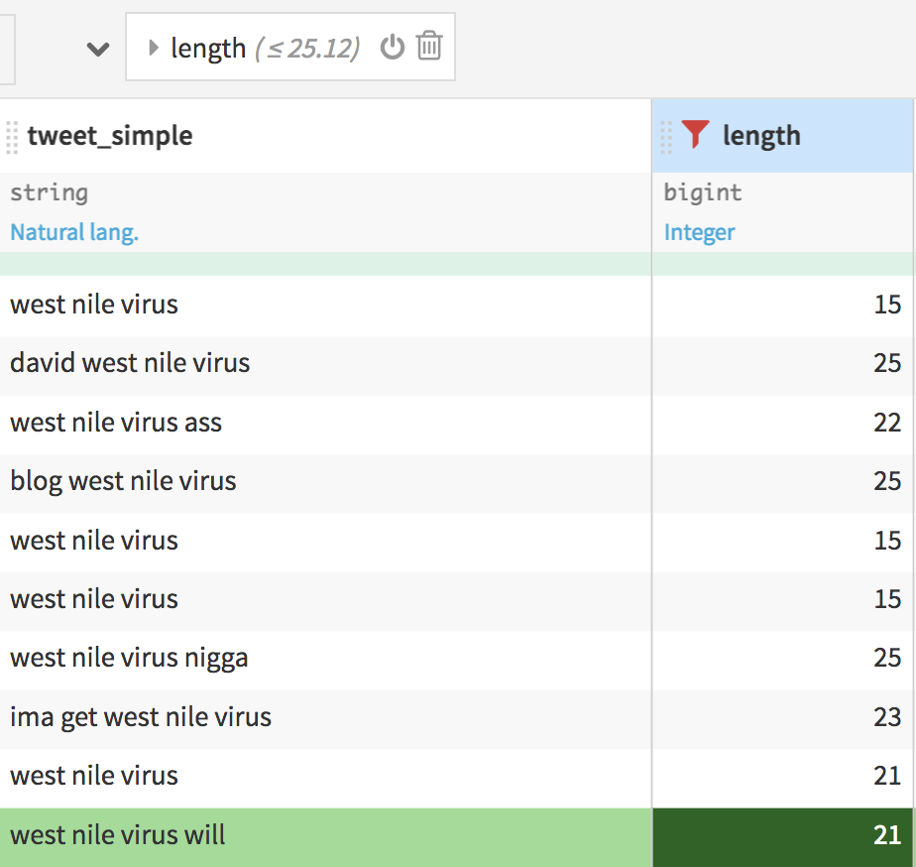
Tweet data
Filter short tweets
TO DO: Filter on the length column to show only rows where length < 25

Slide 24
Tweet data
Filter short tweets
TO DO: Filter on the length column to show only rows where length < 25
Those line are irrelevant, add a new step to remove them

Slide 25
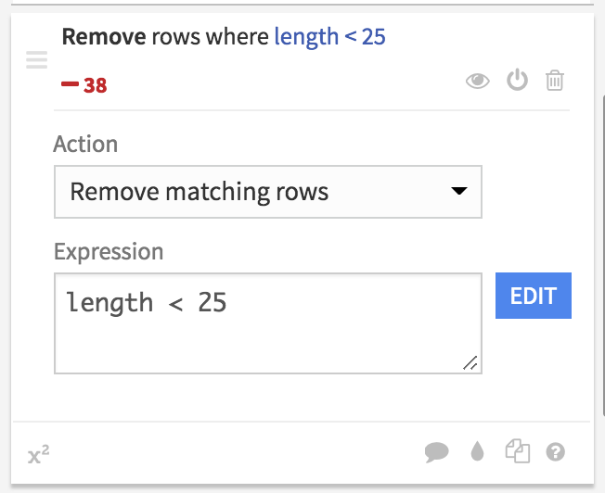
Tweet data
Filter short tweets
TO DO: Filter on the length column to show only rows where length < 25
Those line are irrelevant, add a new step to remove them

Slide 26

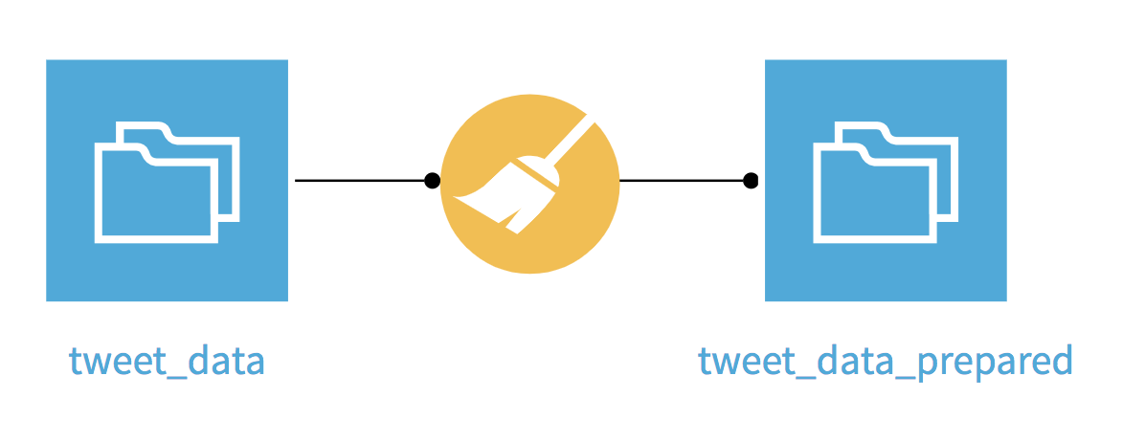
Tweet data
Run the recipe
The tweet data is now enriched and cleaned
TO DO
run the recipe

Slide 27
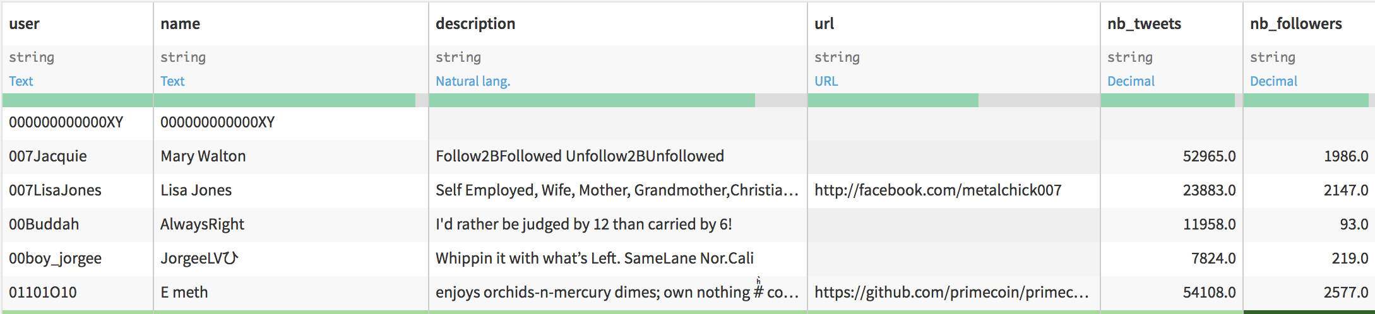
Tweet author data
Author info to enrich the tweet dataset
Let’s add some information about the author to our study.

Slide 28
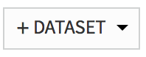
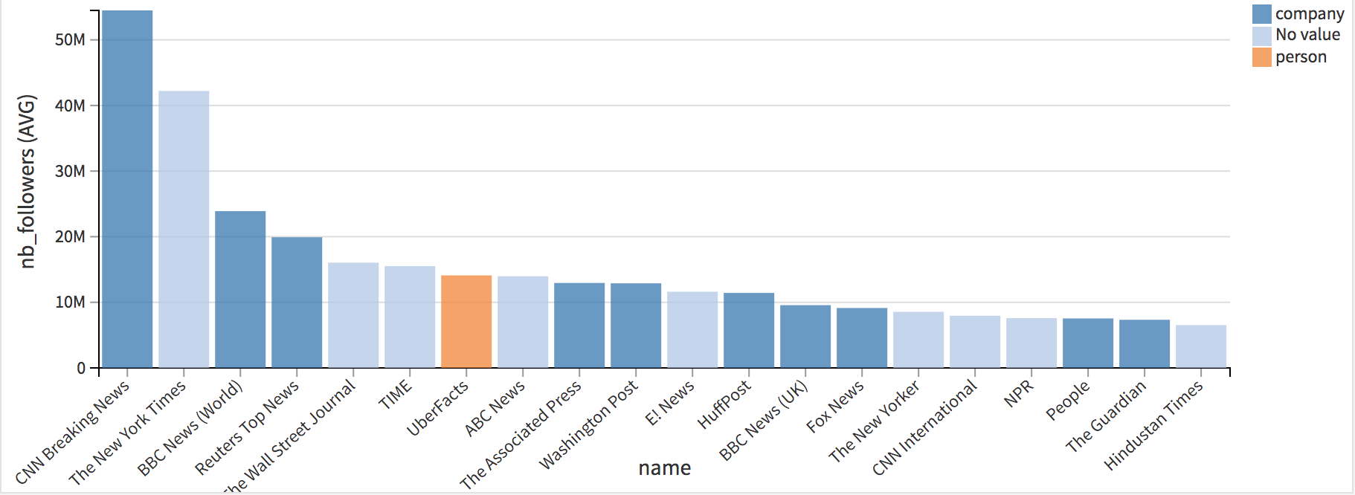
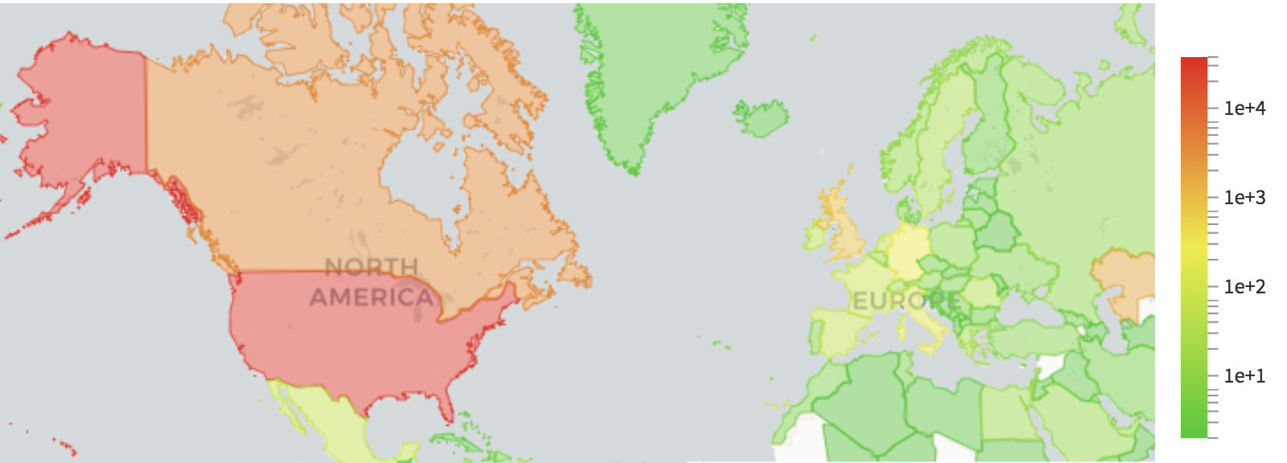
Tweet author data
Author info to enrich the tweet dataset
TO DO:
Create the author dataset from filesystem_root:/data/shared/author_data
Explore the data and build graphs showing
the total number of tweets per country (change the scale to better catch the distribution)
the name of authors with the biggest nb_followers values and the label: human or company
Publish the viz in the dashboard
See solution next slide !
Notes:
Remark that some author are not properly labelled: we estimated the label with human or company website.
Start of coding track

Slide 29

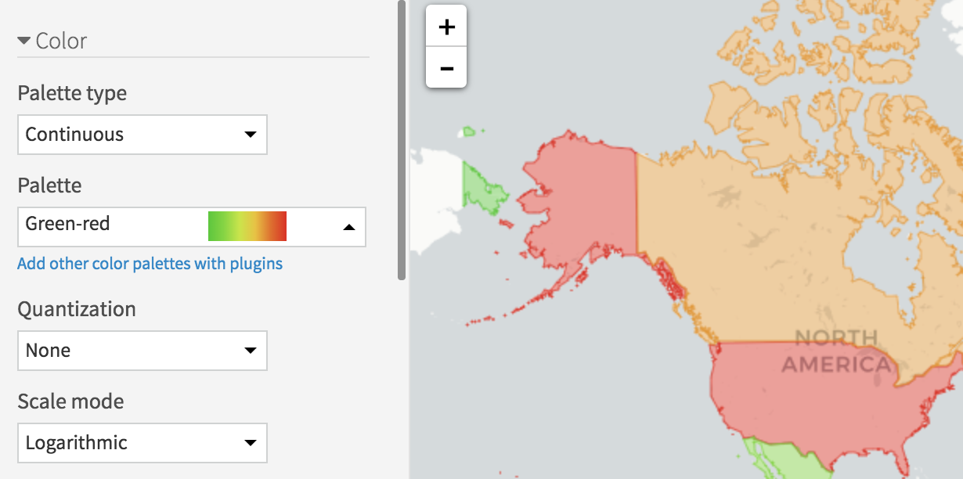
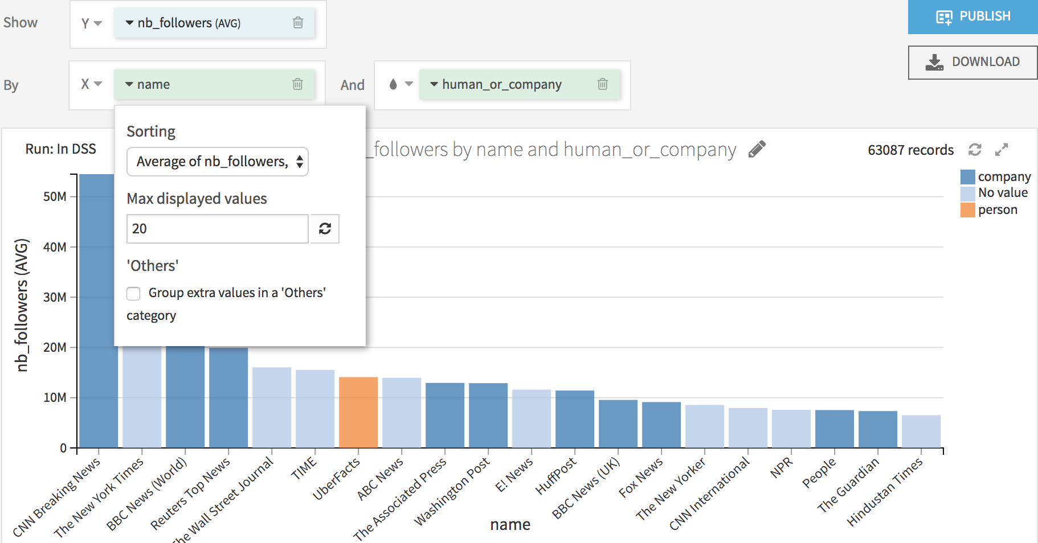
Tweet author data
Author info to enrich the tweet dataset
Notes:
Start of coding track

Slide 30

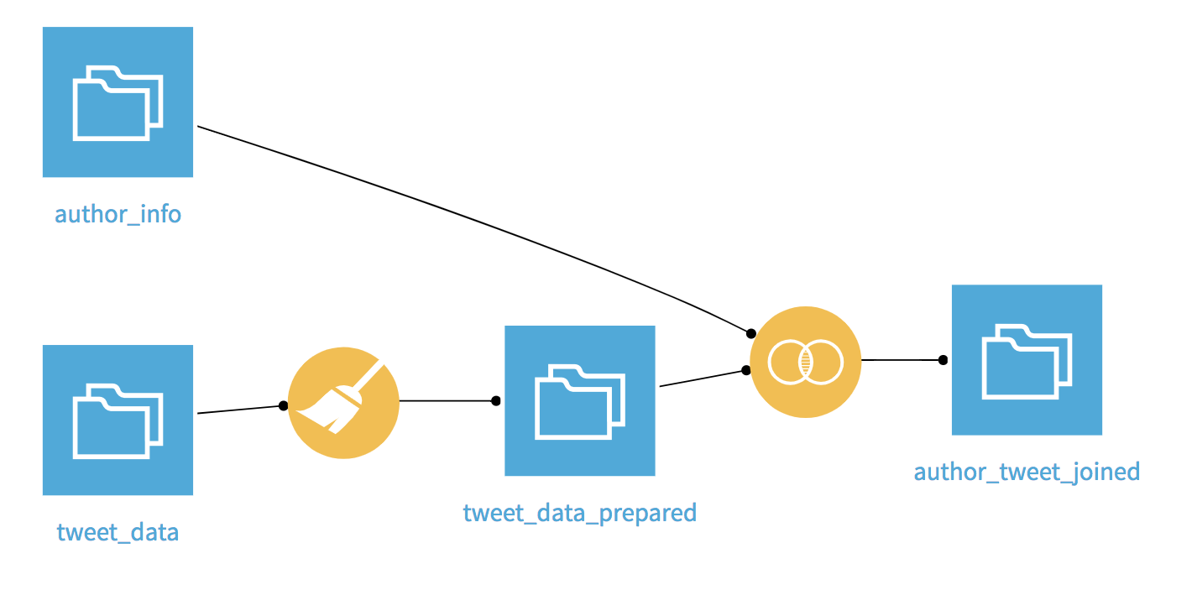
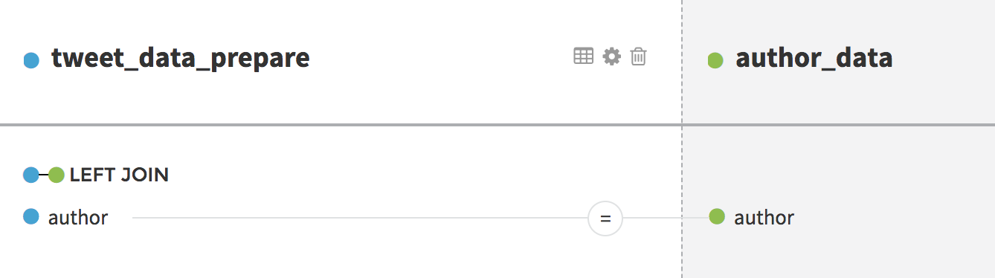
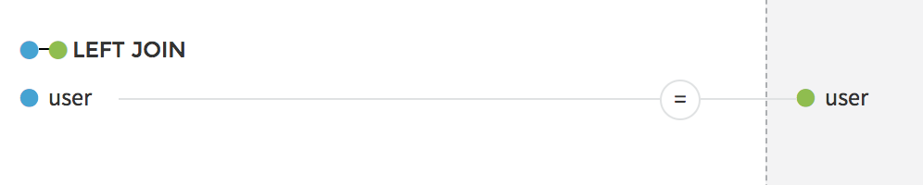
Tweet author data
Author info to enrich the tweet dataset
Now, we enrich the tweet dataset with information about the author of the tweet
TO DO:
Join the author and tweet datasets
Put the author name aside every tweet

Slide 31
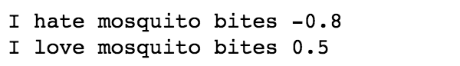
Coding in DSS
In the next slides, to investigate the sentiment of people reactions, we:
Create a column with the polarity of the tweet
Create a wordcloud from the tweets
WHAT’S NEXT ?
These features are not natively included in DSS, they have to be recoded
by you if you are a Python or R coder
by any coder from your team, then a visual interface will be available and you will be able use those features without seeing a single line of code!
Notes:
Start of coding track

Slide 32

What’s next ?
Coding in DSS
For coders go here
For clickers go here

Slide 33
Python and R recipes

Slide 34
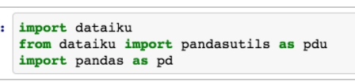
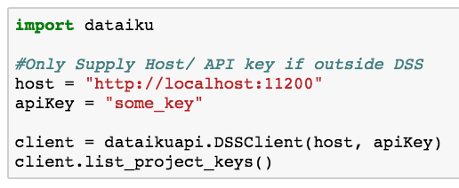
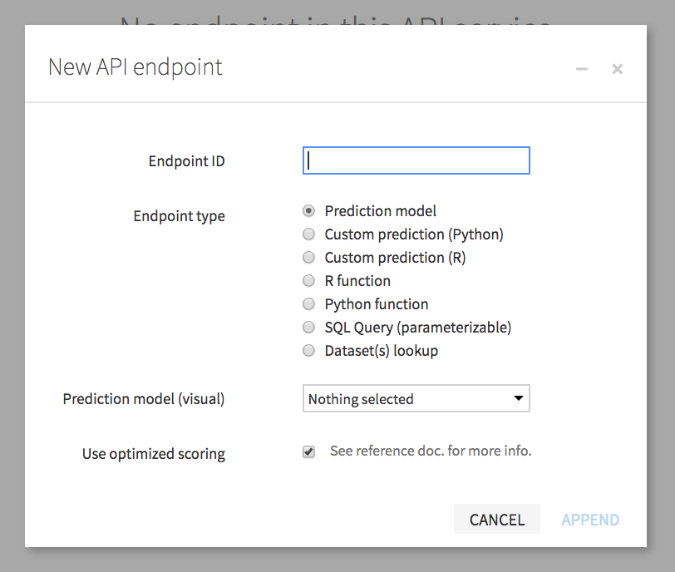
The APIs in DSS
APIs that interacts with many parts of the Platform
CONCEPT
Internal API
Interacting with Datasets, Models, Recipes, performing dynamic SQL queries, and more inside DSS
Python, R, Javascript, and Scala
Python has most functionality
Great to use in Recipes, Notebooks, Custom Scenarios
Public API (DSS REST API)
Can be used internally and in an external system
Can perform a large number of administration and maintenance operations
HTTP REST API and as a Python API Client
API Endpoints
Create Custom Endpoints for real time scoring inside and outside DSS
Endpoints are REST APIs
Custom Python/R functions/models, SQL Queries, and more

Slide 35
The APIs in DSS
DIfferences and Use Cases
CONCEPT
Which API could we use to build the polarity column and wordcloud ?
Internal API
Public API (DSS REST API)
API Endpoints

Slide 36

The APIs in DSS
DIfferences and Use Cases
CONCEPT
Which API could we use to build the polarity column and wordcloud ?
Internal API
Public API (DSS Rest API)
API Endpoints
Python / R recipes and notebooks enable you to have custom recipes that run pure code
In the “dataiku package” DSS has specific functions to read and write data

Slide 37
DSS internal API

Slide 38

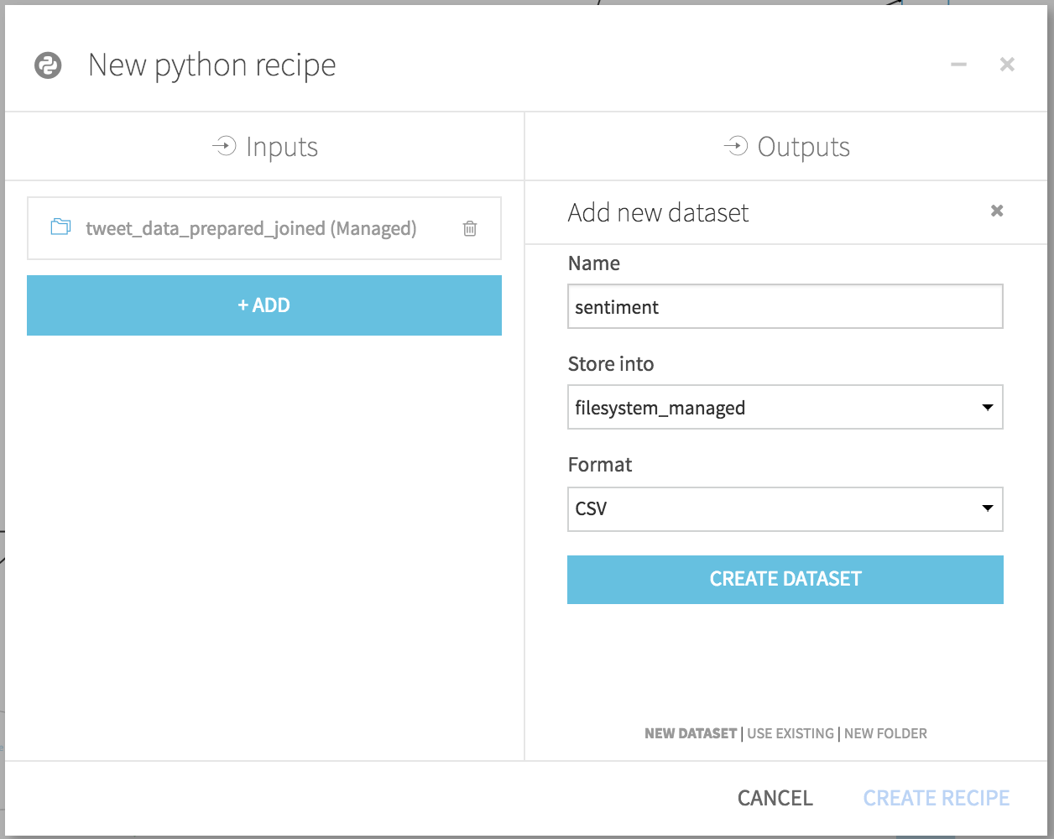
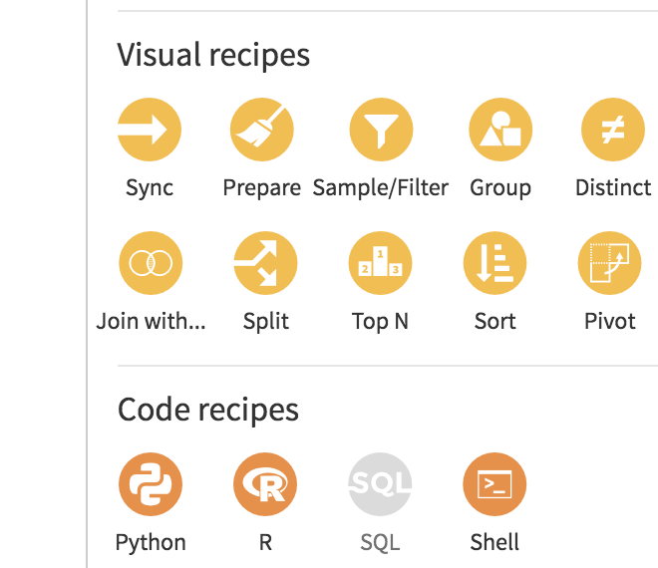
DSS Internal API
Datasets
Creation of a new column with the polarity of the tweet
TO DO Create a Python or R recipe from the latest dataset and name the output dataset sentiment

Slide 39
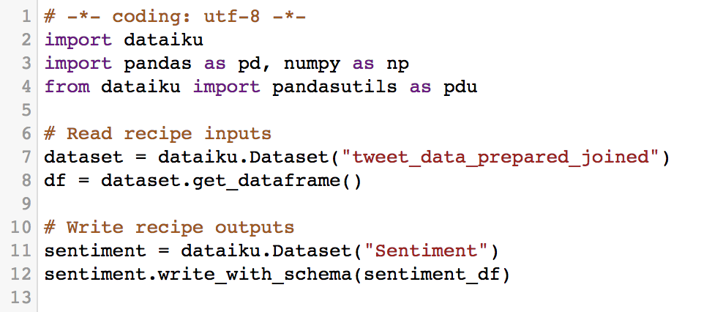
DSS Internal API
Datasets
Look at the code of your recipe
Import dataiku package
Declare a dataiku dataset object
Declare another dataset object
Load the dataset content in memory
Write a pandas dataframe in the output dataset

Slide 40
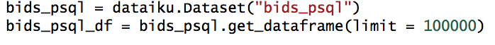
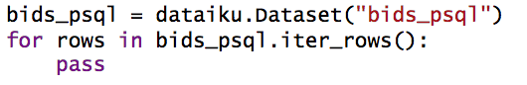
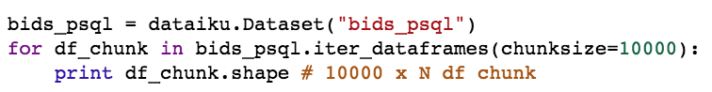
DSS Internal API
What if my input dataset does not fit in memory ?
CONCEPT
Read a sample
Read using stream
Read by DF chunks
For the output, write line by line or by DF chunk

Slide 41
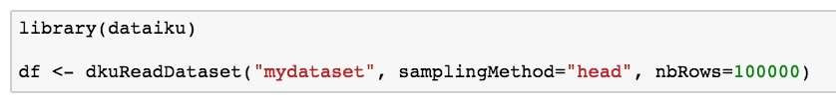
DSS Internal API
What if my input dataset does not fit in memory ?
CONCEPT
Dataiku has no way of chunking R Dataframes
If it doesn’t fit into memory, you can still sample

Slide 42
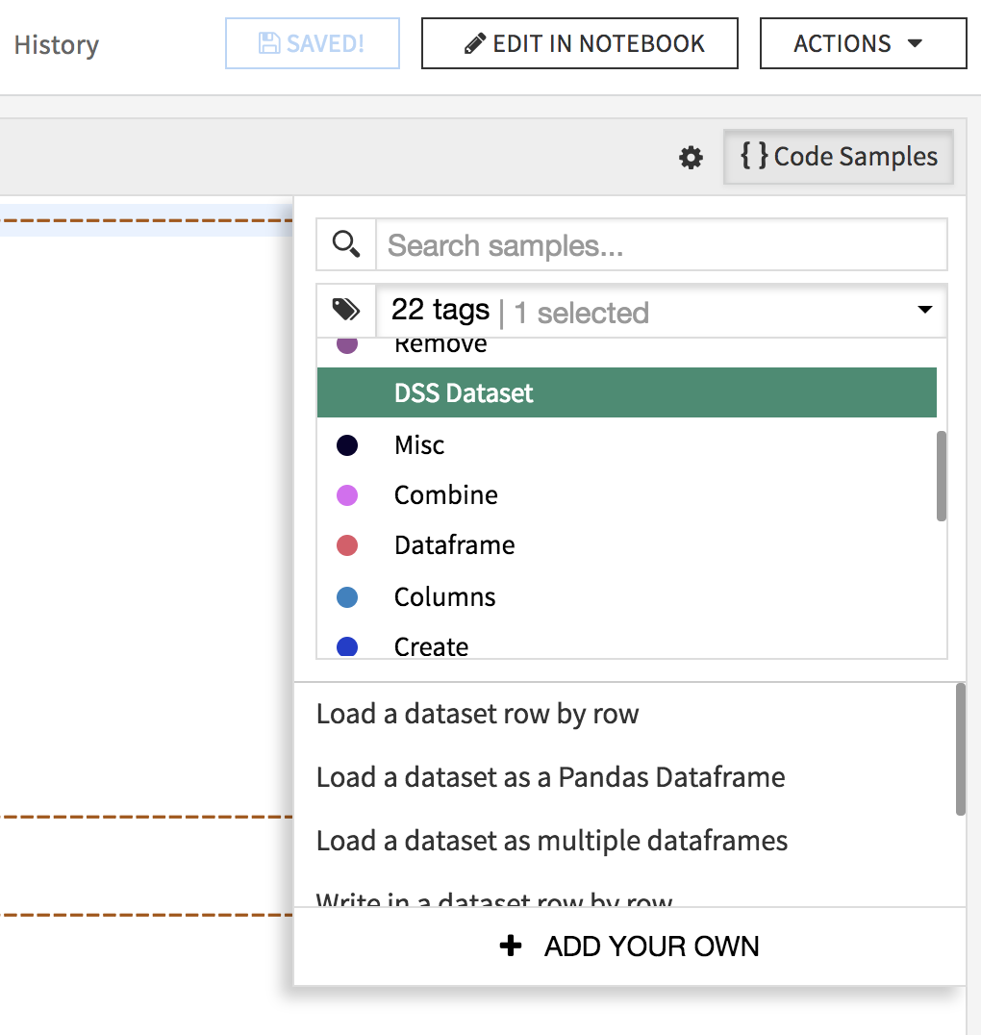
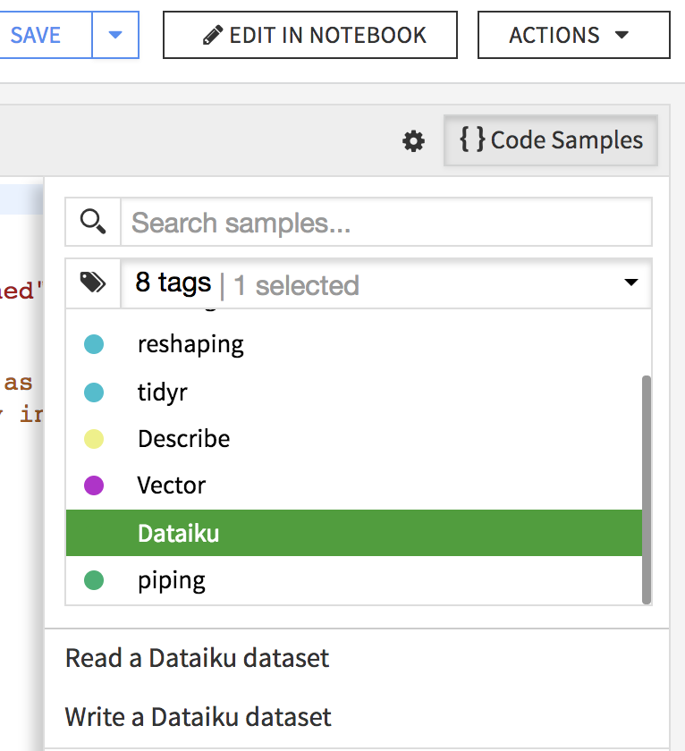
DSS Internal API
Code samples
CONCEPT
The previous code snippets are available in the code samples of the recipe
Python
R

Slide 43
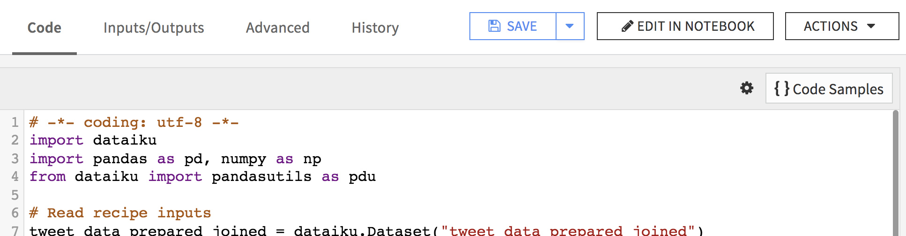
DSS Internal API
Hands on
Debugging the code in the recipe is not easy. It is best practice to use a Notebook
TO DO: Edit the latest recipe in a notebook

Slide 44
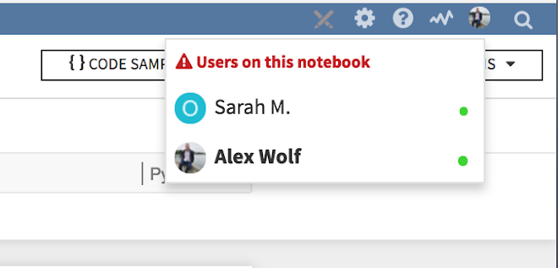
Notebooks
Concepts
CONCEPT
Recipes:
production code
project flow management
reusable across projects
Notebooks:
interactive code design and debugging
charts and reports
Recipes and notebooks are collaborative!
Only one person should work on a recipe/notebook at a time
DSS will notify you if another user is on the same notebook/recipe as you

Slide 45
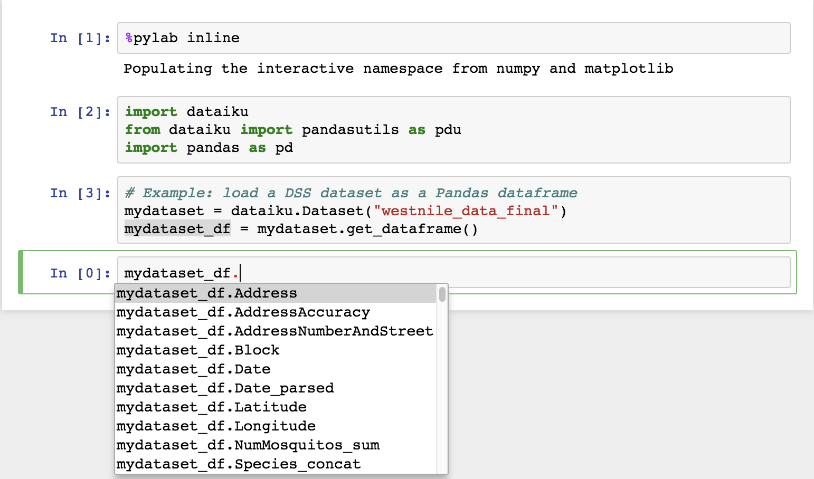
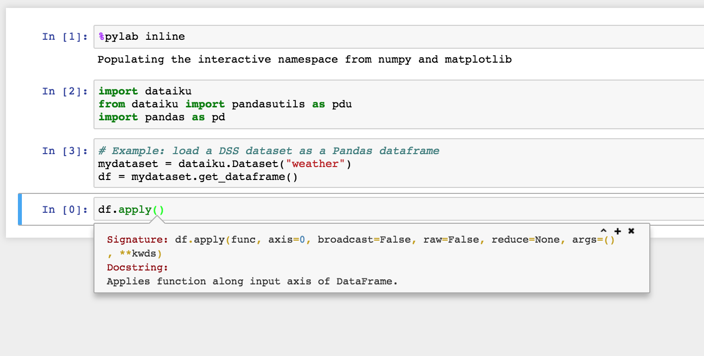
Notebooks
Tips
Try this out!
Doc
Hit Tab on an object to see available attributes/ functions with object
Hit Shift + Tab inside a function to see documentation
Enable this with your own functions using PEP styling guide
Cell code execution
Shift + Enter to execute a cell
Alt/Option + Enter to execute a cell a create a new one below
Notes:
Check position of image

Slide 46
Notebooks
Tips
Let’s compute the sentiment of the tweets using some specific packages.
TO DO: try to import the package textblob (Python) or sentimentr (R)
How to make this package available ?
Use a code env!
What are the benefits of using a code env ?
It ensures reproducibility and consistency
It ensures isolation, teams can work safely without impacting other projects.
Allow people to use different/ run different versions of python
Don’t have libraries break when installing new ones
Better Data Science Collaboration
No need for an Admin to install packages for you
→ Added value provided easily by DSS!
Notes:
Check position of image

Slide 47
Code Environments in DSS

Slide 48

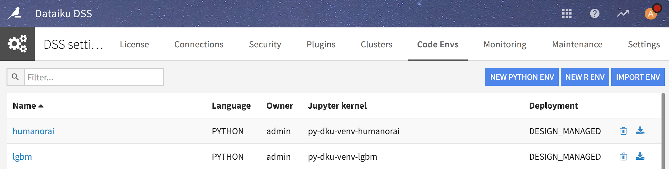
Code Environments in DSS
Intro
CONCEPT
DSS allows for Data Scientists to create and manage their own Python and R code environments, if given permission to do so by an Admin
These Envs can be activated and deactivated for different DSS objects including
Projects, web apps, notebooks, and plugins
To create/ manage Code Envs: Click the menu → Administration → Code Envs

Slide 49
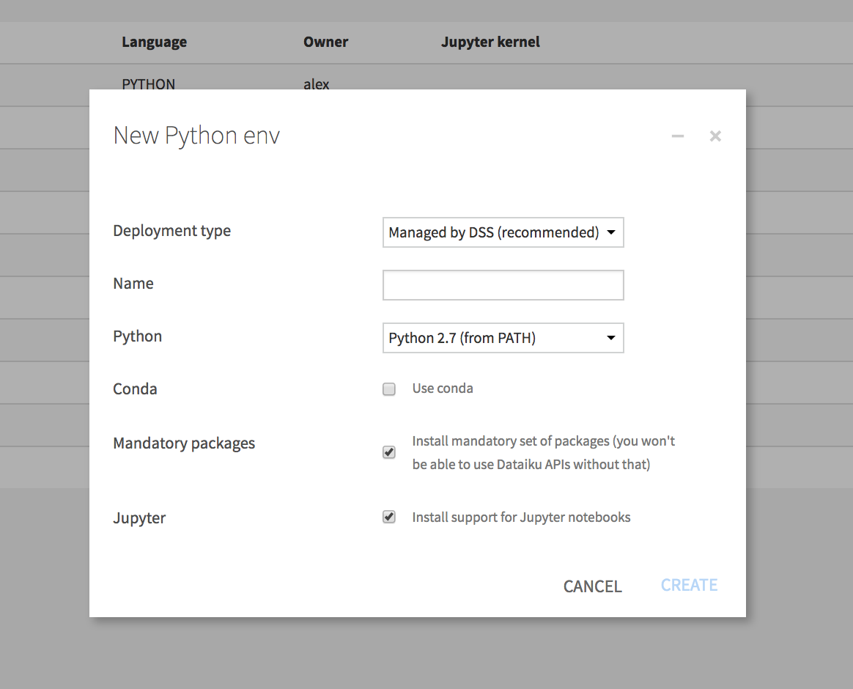
Code Environments in DSS
Creation
CONCEPT
When creating a New Code ENV in DSS, it is best practice to
Keep it Managed by DSS
Install Mandatory Packages for DSS
Install Jupyter Support
Options for
Python Version (2 and 3 supported)
Importing your own ENV
Notes:
Check position of image

Slide 50
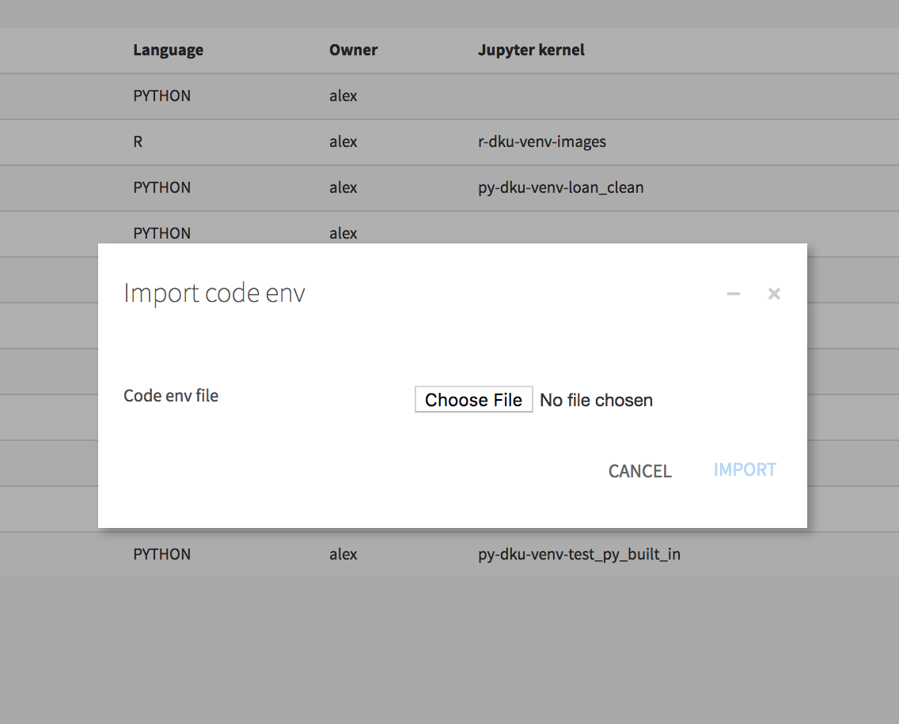
Code Environments in DSS
Uploading a pre-built ENV
CONCEPT
You can upload your own pre-built environment by selecting a file on your computer
Make sure it has these mandatory Dataiku packages for core feature functionality of the Internal Dataiku API (DSS 5.1)
numpy==1.14.0
pandas==0.23.4
python-dateutil==2.5.3
pytz==2016.10
requests==2.12.5
six==1.11.0
Notes:
Check position of image

Slide 51
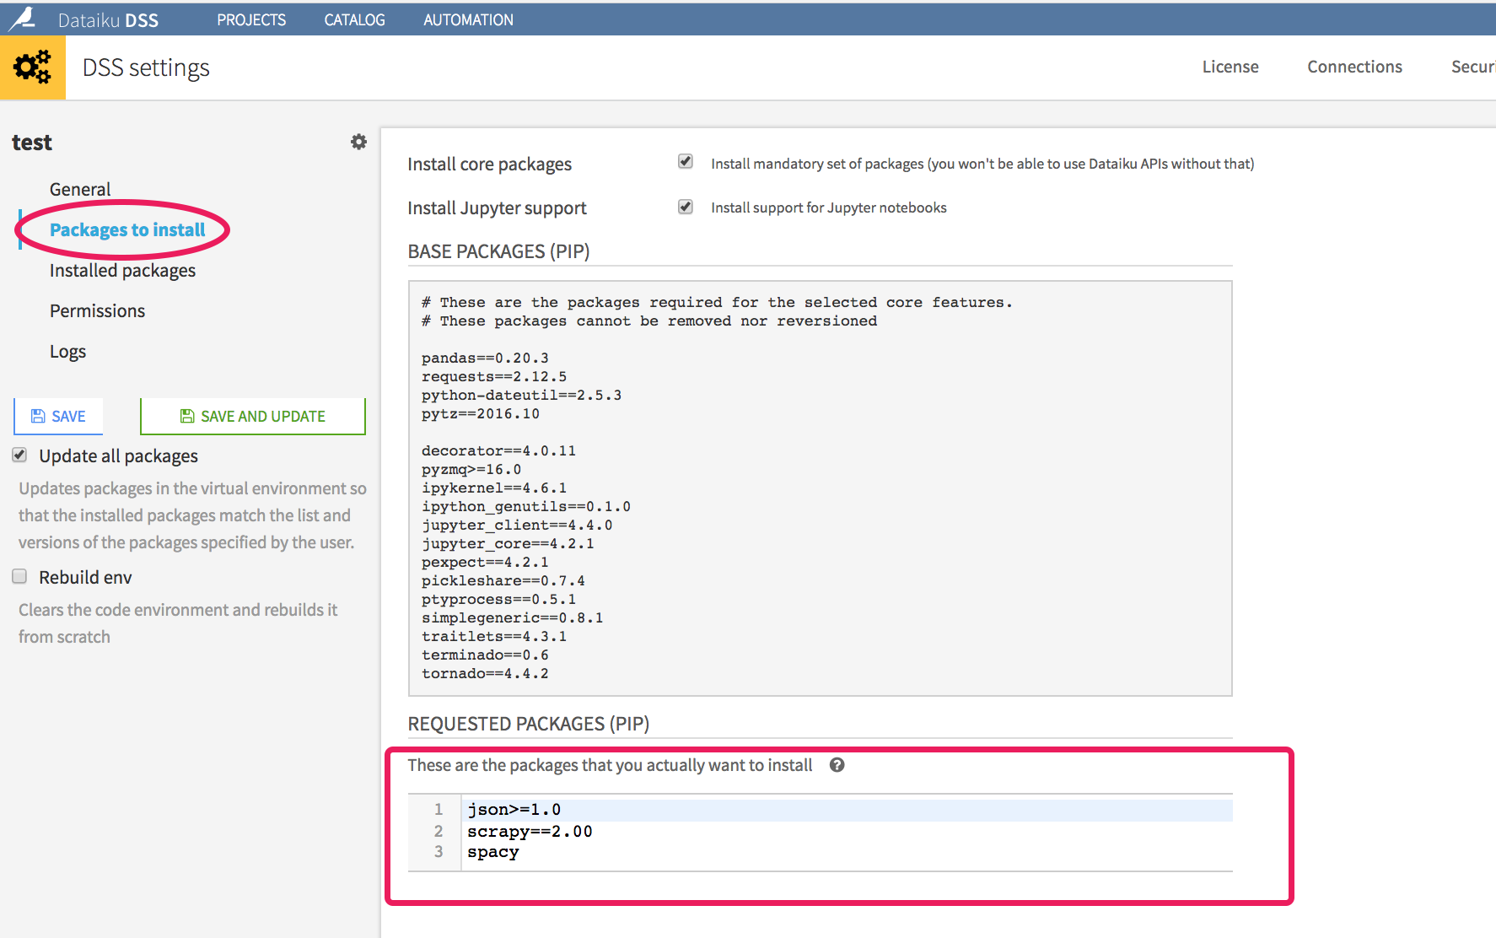
Code Environments in DSS
Installing Packages to your Env
CONCEPT
To Install Packages to your ENV
Click on your ENV in the list of Code ENVS
Go to ‘Packages to Install’ section
Type in the packages you wish to install line by line, as you would for a requirements.txt file
Click Save and Update
Notes:
Check position of image

Slide 52


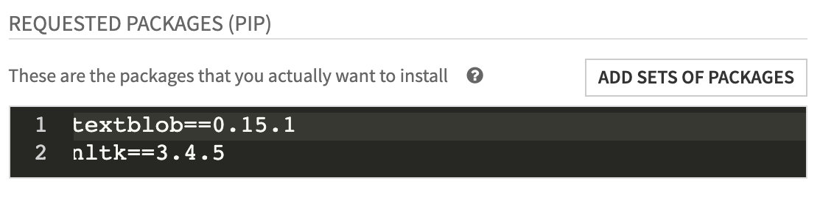
Code Environments in DSS
Hands on
TO DO
Go to → Administration → Code Envs
Create a new Python/ R Environment
my_env_YOUR_NAME
Install mandatory packages and Jupyter support
Install the packages
Python: textblob==0.15.1, nltk==3.4.5 (on separate lines)
R: sentimentr
Notes:
Check position of image

Slide 53
Code Environments in DSS
Remark about R code Envs
R coders should not install the packages through a notebook or a code recipe with install.packages()
It is best practice to
use code Envs
Install the packages through the dedicated DSS interface
One will never say it enough:
It ensures reproducibility and consistency
It ensures isolation, teams can work safely without impacting other project
Notes:
Check position of image

Slide 54
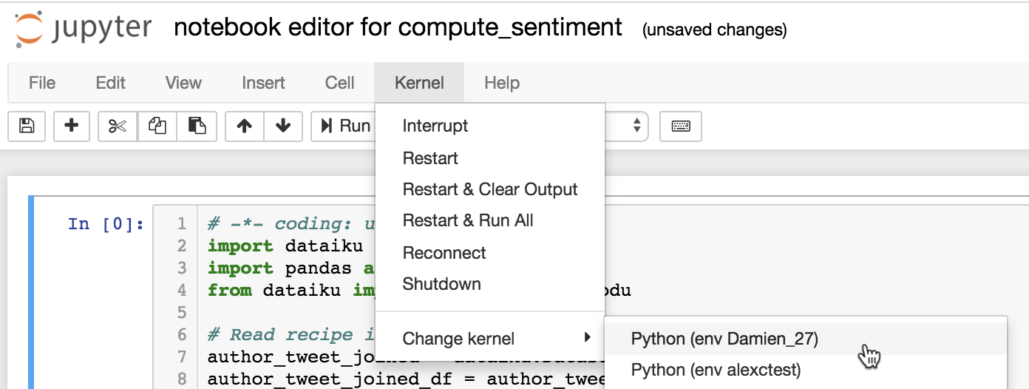
Code Environments in DSS
Hands on
TO DO
Change the Kernel of your notebook to activate a code env in the notebook
try to import the package textblob (with Python) or sentimentr (with R) → It should work now!
Notes:
Check position of image

Slide 55
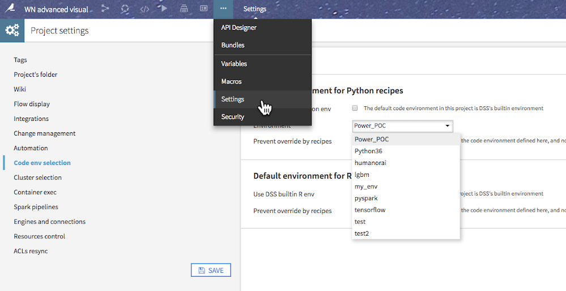
Code Environments in DSS
Activating Code Envs
TO DO
Activate the ENV for all the code recipes in your project
Go to Settings / Code env selection
Select the ENV you want to activate
In addition, you can set the ENV to use for a notebook and other applications separately
Notes:
Check position of image

Slide 56
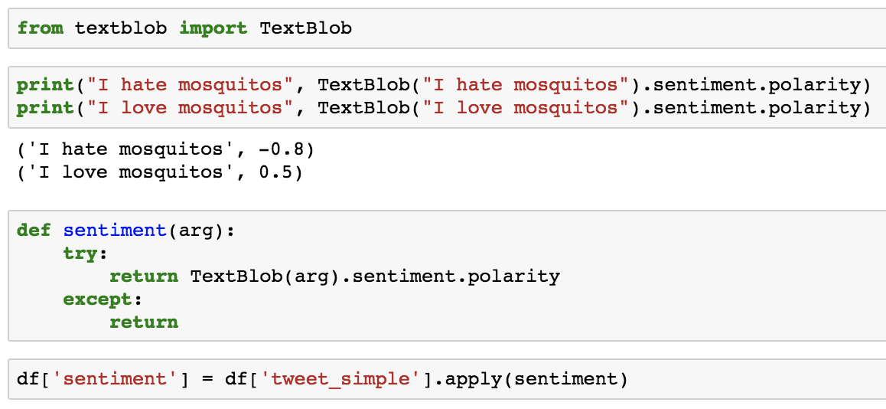
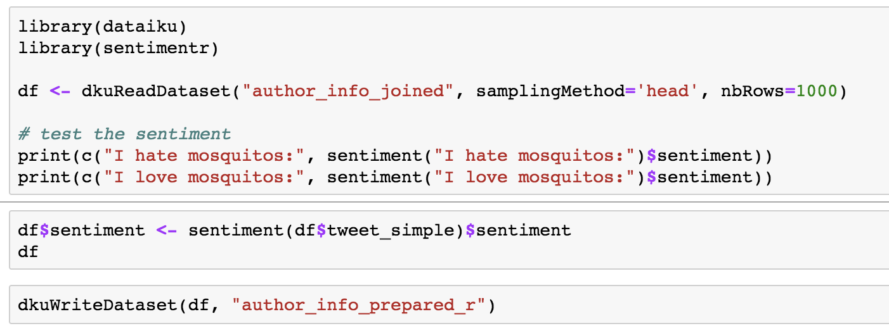
Notebooks
Hands on
TO DO
Go back to your notebook
When reading the dataset do a random sample of 1000 rows
Create a new column sentiment using textblob / sentimentr using the simplified text
Python
R
R
Notes:
#python
import dataiku
import pandas as pd, numpy as np
from dataiku import pandasutils as pdu
from textblob import TextBlob
tweet_data_prepared_joined = dataiku.Dataset("author_info_joined")
df = tweet_data_prepared_joined.get_dataframe()
def sentiment(arg):
try:
return TextBlob(arg).sentiment.polarity
except:
return
df['sentiment'] = df['tweet_simple'].apply(sentiment)
sentiment = dataiku.Dataset("author_info_prepared_python")
sentiment.write_with_schema(df)
# R
library(dataiku)
library(sentimentr)
# Example: load a DSS dataset as a R dataframe
df <- dkuReadDataset("tweet_data_prepared_joined")
df$sentiment = lapply(df$tweet_simple, function(x) sentiment(x)$sentiment)
dkuWriteDataset(df,"sentiment_R")
# python bonus
import dataiku
import pandas as pd, numpy as np
from dataiku import pandasutils as pdu
# Recipe inputs and outputs
in_df = dataiku.Dataset("tweet_data_prepared_joined")
out_df = dataiku.Dataset("sentiment_chunk")
def sentiment(arg):
try:
return TextBlob(arg).sentiment.polarity
except:
return
# Open Dataset Writer and loop through chunks from input
with out_df.get_writer() as writer:
for i, df_chunk in enumerate(in_df.iter_dataframes(chunksize=10000)):
df_chunk['sentiment'].apply(sentiment)
# Write Schema on first chunk
if i == 0:
out_df.write_schema_from_dataframe(df_chunk)
# Append data eveery other time useing writer
else:
writer.write_dataframe(df_chunck)

Slide 57
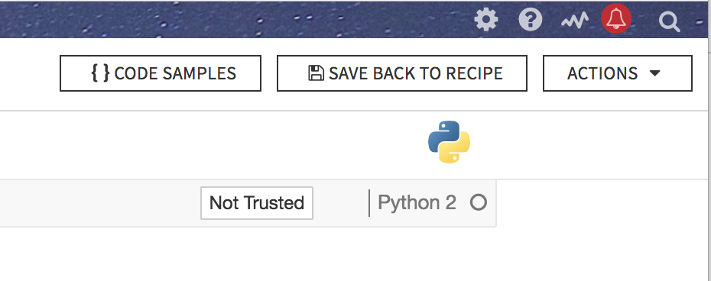
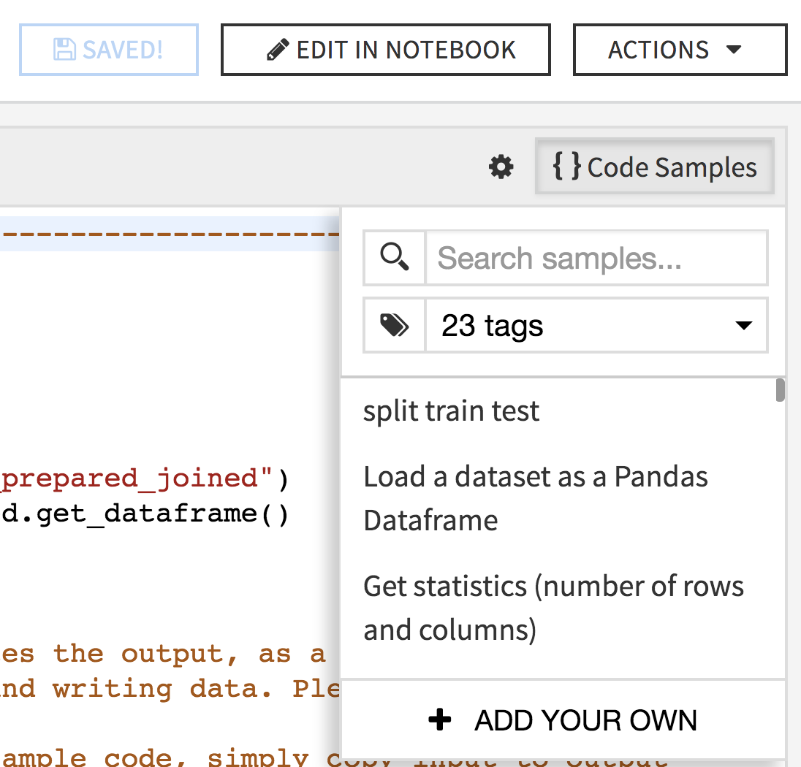
Notebooks
Hands on
TO DO
Save back to recipe
Add to code samples the code to create sentiment column
2.

Slide 58


Hands on
Solutions
Python
R
Notes:
#python
import dataiku
import pandas as pd, numpy as np
from dataiku import pandasutils as pdu
from textblob import TextBlob
tweet_data_prepared_joined = dataiku.Dataset("tweet_data_prepared_joined")
df = tweet_data_prepared_joined.get_dataframe()
def sentiment(arg):
try:
return TextBlob(arg).sentiment.polarity
except:
return
df['sentiment'] = df['tweet_simple'].apply(sentiment)
sentiment = dataiku.Dataset("sentiment")
sentiment.write_with_schema(df)
# R
library(dataiku)
library(sentimentr)
df <- dkuReadDataset("author_info_joined")
# test the sentiment
print(c("I hate mosquitos:", sentiment("I hate mosquitos:")$sentiment))
print(c("I love mosquitos:", sentiment("I love mosquitos:")$sentiment))
df$sentiment <- sentiment(df$tweet_simple)$sentiment
dkuWriteDataset(df, "author_info_prepared_r")
# python bonus
import dataiku
import pandas as pd, numpy as np
from dataiku import pandasutils as pdu
# Recipe inputs and outputs
in_df = dataiku.Dataset("tweet_data_prepared_joined")
out_df = dataiku.Dataset("sentiment_chunk")
def sentiment(arg):
try:
return TextBlob(arg).sentiment.polarity
except:
return
# Open Dataset Writer and loop through chunks from input
with out_df.get_writer() as writer:
for i, df_chunk in enumerate(in_df.iter_dataframes(chunksize=10000)):
df_chunk['sentiment'].apply(sentiment)
# Write Schema on first chunk
if i == 0:
out_df.write_schema_from_dataframe(df_chunk)
# Append data eveery other time useing writer
else:
writer.write_dataframe(df_chunk)

Slide 59


Hands on
Charts
TO DO:
From the sentiment dataset, compute the average sentiment for person and company
Export the graph to your dashboard

Slide 60


Hands on
Split positive and negative tweets
TO DO:
Split the latest sentiment dataset into two datasets, according to the value of the sentiment. Exclude sentiment = 0
sentiment_pos
sentiment_neg

Slide 61

Hands on
Split positive and negative tweets

Slide 62
Building a word cloud
Highlight people's reactions
Now we build WordClouds from the tweets
We export the WordClouds in a folder for external reuse (external presentation for example)
We create the WordClouds in a code recipe and export it to a dashboard as a static insight
→ Let’s go through these two new concepts: folder and static insight

Slide 63
Working with Folders

Slide 64

Working with Folders
Sometimes Datasets aren’t Enough
CONCEPT
Datasets may not be enough to store all you need in a data science project. You might need:
machine learning models to use in a scoring recipe
keras .h5 file model
collection of JPEG/PNG images
…
⇒ To keep the dependencies in the flow, use folders!

Slide 65

Working with Folders in Code
Hands on
To do:
From the sentiment_pos dataset, create a Python or R recipe that outputs a folder
Specify here you output a Folder

Slide 66


Working with Folders in Code
How to and hands on
Try this out!
To work with Folders in DSS with code
get the folder path
interact with it how you would with a regular directory path
To connect with Python To connect with R:

Slide 67


Working with Folders in Code
Hands on
To do:
Add the package(s) to your environnement
Python: wordcloud
R: tm, wordcloud
In the recipe, create a wordcloud and save it in the folder
Run the recipe
In R, take only 1000 rows
Notes:
###########################R###########################
library(dataiku)
# Recipe inputs
df <- dkuReadDataset("sentiment_pos", samplingMethod="head", nbRows=1000)
library("tm")
library("wordcloud")
path_folder <- dkuManagedFolderPath("YOURFOLDER_ID")
path_save <- paste0(path_folder, '/', 'word_cloud.png')
png(path_save)
wordcloud(df$tweet_simple)
dev.off()
###########################PYTHON###########################
# -*- coding: utf-8 -*-
import dataiku
from dataiku.customrecipe import *
import pandas as pd, numpy as np
from dataiku import pandasutils as pdu
import matplotlib
import wordcloud
matplotlib.use('Agg')
import matplotlib.pyplot as plt
# Read recipe inputs
sentiment_pos = dataiku.Dataset("sentiment_pos_1")
df = sentiment_pos.get_dataframe()
folder = dataiku.Folder("43ykE6q4")
wordcloud_path = folder.get_path()
## wordcloud creation
wc = wordcloud.WordCloud(
background_color='white',
max_font_size=40,
scale=3
).generate(str(df["tweet_simple"]))
fig = plt.figure()
plt.axis('off')
plt.imshow(wc)
plt.show()
## save the wordcloud to the output folder
path_fig = wordcloud_path + '/' + "wordcloud"
plt.savefig(path_fig)
## export the wordcloud as a static insight
import dataiku.insights
id = "wordcloud_pos"
dataiku.insights.save_figure(id)

Slide 68


Working with Folders
Manual Interaction
To do: Explore the folder
More Folder Actions
Download file
Upload file

Slide 69


Folder
Copy the recipe
To do
We want the same WordCloud for the negative tweets
Copy the Python / R recipe (and modify the code if needed)

Slide 70
Static insights
Embed data and charts in dashboards

Slide 71
Static insights
Embed data and charts in dashboards
CONCEPT
Sometimes built-in chart functionalities are not enough
Dataiku has a feature to export an image created in your code to a dashboard: Static insights !
Export data and charts created in code recipes and notebooks to dashboards.
Static insights are updated each time you run the code
Python
Plot.ly
Matplotlib
Bokeh
ggplot
R
ggplot2
dygraphs
ggvis
googleVis

Slide 72



Static insights
Embed data and charts in dashboards
Hands on is Python only, ggplot does not have native wordcloud function
To do
To export the wordcloud_pos and wordcloud_neg figures as static insight:
add these lines at the end of your code
Add the static insights to your dashboard
2
1
Notes:
import dataiku.insights
id_fig = "wordcloud"
dataiku.insights.save_figure(id_fig, figure = fig)

Slide 73
Notebooks in DSS
Deep dive

Slide 74
What’s next ?
CONCEPT
We used notebook to prototype our Python / R recipe
Notebooks in DSS have more functionalities
Sometimes we just want a notebook, and decide later to transform it to a recipe or not → DSS enable you to create collaborative notebooks
DSS has predefined notebooks to help you analyse your data
Any visual ML model can be exported to a Python notebook

Slide 75


Notebooks
Notebooks can also be created from the lab
TO DO:
Create a notebook from the latest created dataset using the LAB button

Slide 76

Notebooks
Starter code
CONCEPT
When creating a new notebook, you will find a starter code.

Slide 77

Notebooks
Notebook → Recipe
CONCEPT
You can convert, or not, notebooks into recipes with a button click
Best practice for prototyping recipes in DSS
Python, R, SQL, Hive, Impala, and Scala can all convert

Slide 78

Notebooks
Predefined
CONCEPT
You can create predefined notebooks that can help you on specific tasks such as:
Correlation Analysis
PCA or t-SNE
Topic Modelling
Time series
...
Use Plugin Dev Console to create more
Use the lab to find these notebooks

Slide 79



Notebooks
Hands on
TO DO
With the tweet_prepared data, choose the predefined notebook “Topic modeling”
Execute all the cells, pay attention to the followings
Change the kernel to training_python
In the 4th cell of the notebook, replace the raw text column name with the simplified text one

Slide 80

Notebooks
Hands on
TO DO
Observe the topics that popped up with the proposed method
Any ideas on how to get rid of unwanted words such as ‘http’, ‘tinyurl’, … ?
Notes:
change the stopword list!

Slide 81

Notebooks
Downloading
CONCEPT
You can download notebooks in DSS
Choose a notebook and go to File -> Download as -> Notebook (.ipynb)
Other download types available also
Notes:
Maybe bonus: save as Static Insight
https://doc.dataiku.com/dss/latest/api/python/static_insights.html

Slide 82

Notebooks
Deleting
CONCEPT
To Delete notebooks in DSS
Go to the notebook page
Check the Notebooks you want to delete
Go to Actions → Delete
Notes:
Maybe bonus: save as Static Insight
https://doc.dataiku.com/dss/latest/api/python/static_insights.html

Slide 83



Notebooks
Tips
TO DO
Add markdown to comment your code
Publish your notebook in your dashboard
Notes:
Check position of image

Slide 84

Notebooks
Concepts
WARNING: Notebooks don’t release the memory they use. You have to kill them on your own.
TO DO: Kill your notebook from DSS interface
Notes:
You can kill all old notebooks using a macro

Slide 85
Now please go here
Notes:
Check position of image

Slide 86
Flow views and actions

